Slide 1

Handwritten Digit Recognition System Using Machine Learning
Presented By
Gourav Sharma(2000320120075)
Harsh Kumar Upadhyay (2000320120080)
Harsh Mishra (2000320120081)
Rahul Dabola(2000320120130)
Guided By
Mrs Ashi Aggarwal
Department of Computer Science & Engineering

Slide 2






INTRODUCTION
What is Handwritten Digit Recognition? Handwritten digit recognition is the ability of a computer to recognize the human handwritten digits from different sources like images, papers, touch screens, etc. and classify them into 10 predefined classes (0-9).
Why we need it? Digit recognition has many applications like number plate recognition, postal mail sorting, bank check processing, etc.
How will we do it? The mentioned project will be implemented with the help of machine learning algorithms applied using python programming language and the various libraries associated with it.

Slide 3
Technologies Required
Python
MNIST Dataset
TensorFlow
Keras
Tkinter(GUI)

Slide 4
BACKGROUND
With the humanization of machines, there has been a substantial amount of research and development work that has given a surge to deep learning and machine learning along with artificial intelligence.
Handwritten digit recognition (HDR) is considered one of trivial and critical machine learning problems. It has been used widely by researchers as experiments for theories of machine learning algorithms for many years.
Likewise, handwritten text recognition is an important application of deep learning and machine learning which is helpful in detecting forgeries and a wide range of research has already been done that encompasses a comprehensive study and implementation of various popular algorithms.

Slide 5
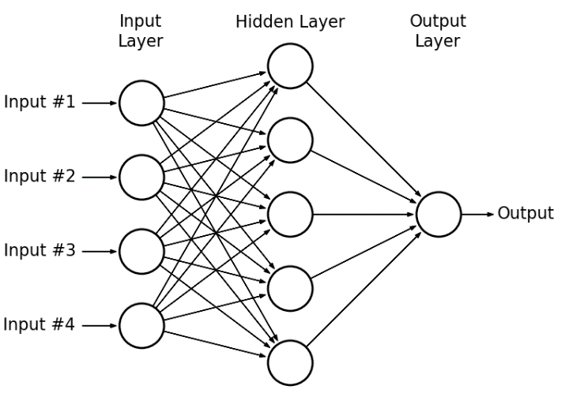
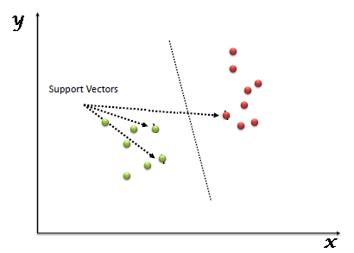
Various Algorithms Used:
Multilayer Perceptrons: Multilayer perceptron consists of three different layers, input layer, hidden layer and output layer used to classify the handwritten digits.
Support Vector Machines: SVM is a supervised ML method that intends to classify the data points by maximizing the margin among classes in a high-dimensional space.

Slide 6
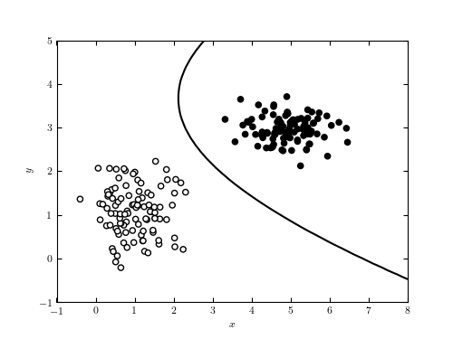
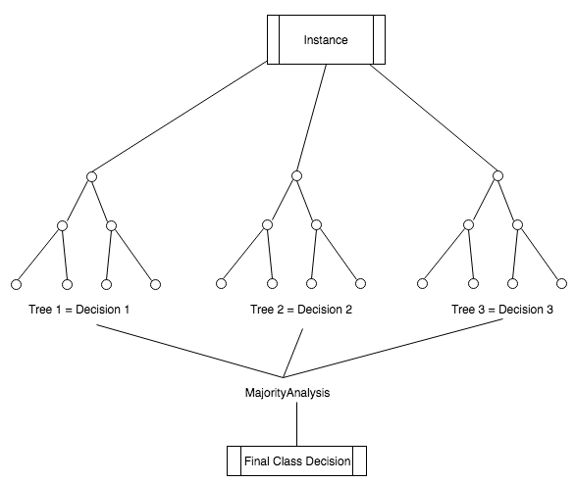
Naive Bayes: It is a probabilistic classifier which relies upon Bayes theorem with robust and naive independence assumptions. It is termed naive due to it relies on two important simplifying assumes that predictive attributes are conditionally self-reliant given the class, and it considers that no hidden attributes influence the prediction method.
Random Forest: In this algorithm, prediction is made by accumulating the predictions of the ensemble by superiority voting for classification. It returns generalization error rate and is more potent to noise.

Slide 7
PROBLEM STATEMENT
The problem statement for this project states the creation of a handwritten digit recognition system using machine learning for the conversion of handwritten decimal numbers to binary numbers(and/or other number systems).
The need of converting very long decimal numbers to other number systems that may be hard to type(due to a typing mistake being made) as compared to writing them on a paper instead helped us formulate the problem statement for this particular project. This will also help us to understand how various number systems work and are converted to one another. Implementing the small details for number system conversion will also help us become detail-oriented and not just focus on implementing the required machine learning algorithm to complete the project.
Solution of this problem statement will take place with the help of applying various machine learning studies alongside numerous programming techniques
Included within the computer science domain.

Slide 8
PROPOSED WORK
Our aim in the proposed work is to recognize user-defined handwritten digits and identify the complete number(in decimal number system by default) that is input by the user which is then converted to binary number system(and/or other number systems).
A graphical user interface(GUI) will be created for the same in which the user can input an image that will be then used to get a particular result based on the functionalities implemented within this project.
A machine learning model is to be created that will be trained and tested using a specific dataset.
Weights/Bias will be set while training the model and the model will then be evaluated based on specific conditions to provide the desired output.

Slide 9
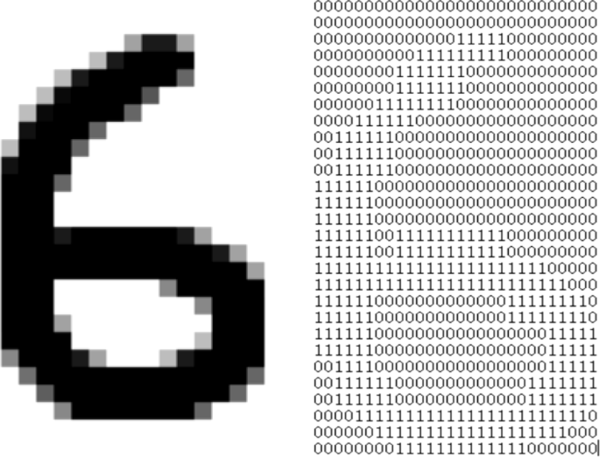
Here, our machine learning model will process the given gray-scale input image and derive a pattern using the relative 1's and 0's to recognize the input and produced the desired output in the form of a number label.
The image on the right shows how a handwritten digit I.e., a '6' is recognized as a pattern of 1's and 0's according to its black and white pixels.
This processed input will then be used accordingly to satisfy the functionalities implemented within our system.

Slide 10
SYSTEM DESIGN
System design for a hand written digit recognition system is one of the key elements that should be implemented properly.
For doing so, we will be using the MNIST dataset and pre-process the images provided within it before classification.
Classification will then be done on the basis of a machine learning algorithm(for e.g., Convolutional Neural Networks(CNN))
The model will then be trained and evaluated to provide accurate results.

Slide 11
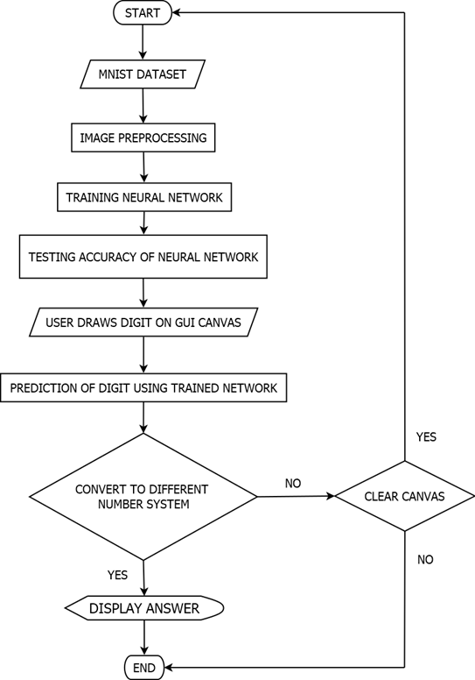
ACTIVITY
DIAGRAM

Slide 12
IMPLEMENTATION
Here, our project will be implemented using the MNIST dataset. At first, the libraries alongside the dataset will be loaded into python. The dataset consists of 70,000 28*28 grayscale images for both testing and training the model.
The data will then be preprocessed before it is fed into the model.
The machine learning model will then be created.
The model will then be trained on the basis of the training dataset with the help of several python libraries that were preloaded to perform these specific tasks.
The model will then be evaluated on the basis of the testing dataset.
Finally, the Graphical User Interface(GUI) will be created using the Tkinter library.

Slide 13
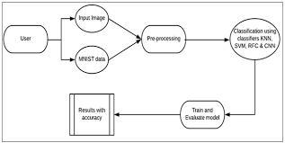
The user will be enabled to draw handwritten digits on a canvas widget that will be provided within the GUI.
These handwritten digits will then be recognized according to the trained machine learning model which was created earlier. This machine learning model will be incorporated in the GUI created.
After the recognition of these digits is complete the overall recognized number will be displayed alongside the predicted labels and the corresponding accuracies
The user will then be provided with functionalities to convert this overall recognized number(in decimal format by default) to binary/hexadecimal/octal equivalent by using the button widgets provided within the GUI.

Slide 14
CONCLUSION
With this presentation, we would like to conclude out project titled "Handwritten digit recognition using machine learning for converting decimal numbers to other number systems" by properly identifying the digits drawn at different angles and producing the desired results based on this identification.
Limitations:
Implementing this technology(I.e., handwritten digit recognition) on a large scale could evidently bring about several repercussions. Recognizing handwritten digits, if not used with good intentions, could lead to the manifestation of several social issues. People may use such a technology to identify bank pins, atm pins, etc. to perform monetary felonies.
Future Scope:
As the world is progressing towards automation, the use of such technology can have a great impact in the future. It can help several industries such as banking, postal, shipping, automobile, etc.
Furthermore it can be improved to automate the process of scanning digits/text information to help support many complex real-time applications.

Slide 15
REFERENCES
[1] Swapna Prava Ekka, “Recognition of Handwritten Digits using Proximal Support Vector Machine”, (2014), National Institute of Technology Rourkela, unpublished.
[2] Viragkumar N. Jagtap, Shailendra K. Mishra, “Fast Efficient Artificial Neural Network for Handwritten Digit Recognition”, (IJCSIT) International Journal of Computer Science and Information Technologies, Vol. 5 (2), (2014), ISSN Number: 0975-9646, pp. 2302-2306.
[3] Saeed AL-Mansoori, “Intelligent Handwritten Digit Recognition using Artificial Neural Network”, Journal of Engineering Research and Applications, Vol. 5, Issue 5, (Part -3) May (2015), ISSN : 2248-9622, pp.46-51.
[4] S M Shamim, Mohammad Badrul Alam Miah, Angona Sarker, Masud Rana, Abdullah Al Jobair, “Handwritten Digit Recognition using Machine Learning Algorithms”, Journal of Computer Science and Technology: DNeural & Artificial Intelligence, vol. 18, Issue 1, (2018), ISSN: 0975-4172, pp.0975-4350.
[5] Md. Anwar Hossain, Md. Mohon Ali, “Recognition of Handwritten Digit using Convolutional Neural Network (CNN)”, Journal of Computer Science and Technology: D Neural & Artificial Intelligence, Vol. 19, Issue 2, (2019), ISSN: 0975-4172, pp.0975-4350.

Slide 16
REFERENCES
[6] Kiran Banjare, Sampada Massey, “Handwritten Numeric Digit Classification and Recognition: Recent Advancements”, Journal of Emerging Technologies in Engineering Research (IJETER), Vol. 4, Issue 6, June (2016), ISSN: 2454-6410.
[7] Savita Ahlawat, Amit Choudhary, Anand Nayyar, Saurabh Singh, Byungun Yoon, “Improved Handwritten Digit Recognition Using Convolutional Neural Networks (CNN)”, (2020), unpublished.
[8] Aarti Gupta, Rohit Miri, Hiral Raja, “Recognition of Automated Hand-written Digits on Document Images Making Use of Machine Learning Techniques”, Journal of Engineering and Technology Research, (2021), ISSN: 2736-576X.
[9] V. Gopalakrishan, R. Arun, L. Sasikumar, K. Abhirami, “Handwritten Digit Recognition for Banking System”, Kings College of Engineering, Punalkulam, Pudukottai, Journal of Engineering Research & Technology (IJERT), (2021), ISSN: 2278-0181.
[10] Ritik Dixit, Rishika Kushwah, Samay Pashine, “Handwritten Digit Recognition using Machine and Deep Learning Algorithms”, Journal of Computer Applications, Vol. 176 – No. 42, July (2020), pp.0975 – 8887.

